Slide 1



Splash Screen

Slide 2
Lesson Menu
Five-Minute Check (over Lesson 6–2)
Then/Now
New Vocabulary
Example 1: Real-World Example: Use Dimensional Analysis
Example 2: Real-World Example: Convert Rates
Key Concept: Measurement Conversions
Example 3: Convert Measurements Between Systems
Example 4: Real-World Example: Convert Rates Between Systems

Slide 3

5-Minute Check 1
Express the rate as a unit rate. Round to the nearest tenth if necessary.
230 miles in 4.5 hours
A. 53.1 mi/h
B. 52.1 mi/h
C. 51.1 mi/h
D. 50.1 mi/h

Slide 4

5-Minute Check 2
Express the rate as a unit rate. Round to the nearest tenth if necessary.
54 pages in 30 minutes
A. 1.8 pages/min
B. 1.6 pages/min
C. 1.4 pages/min
D. 1.2 pages/min

Slide 5

5-Minute Check 3
Express the rate as a unit rate. Round to the nearest tenth if necessary.
$4.80 for 5 popsicles
A. $0.98/popsicle
B. $0.96/popsicle
C. $0.94/popsicle
D. $0.92/popsicle

Slide 6

5-Minute Check 4
Express the rate as a unit rate. Round to the nearest tenth if necessary.
25 steps in 18 seconds
A. 1.7 steps/s
B. 1.6 steps/s
C. 1.5 steps/s
D. 1.4 steps/s

Slide 7

5-Minute Check 5
In 4 hours, Richard can wash 5 cars. At this rate, how long will it take him to wash 9 cars? Write your answer in hours and minutes.
A. 8 h 30 min
B. 8 h 14 min
C. 7 h 12 min
D. 6 h 52 min

Slide 8

5-Minute Check 6
Jim walked at a rate of 4 miles per hour for 1.5 hours and then 3 miles per hour for 2 hours. How far did he walk in all?
A. 13 miles
B. 12 miles
C. 7 miles
D. 6 miles

Slide 9


Then/Now
You have already learned to find unit rates. (Lesson 6–2)
Convert rates using dimensional analysis.
Convert between systems of measurement.

Slide 10

Vocabulary
dimensional analysis

Slide 11
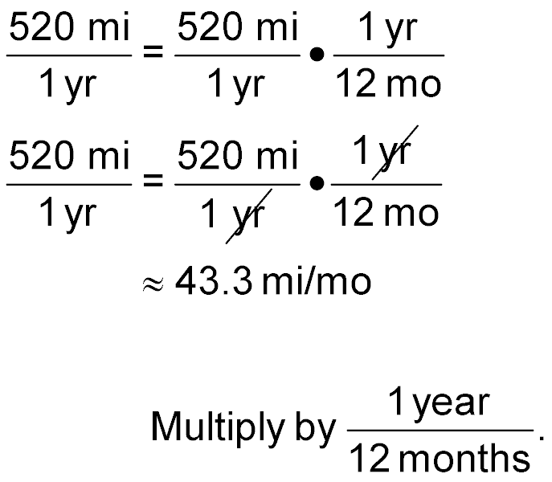
Example 1
Use Dimensional Analysis
Convert 520 miles per year to miles per month.
You need to convert miles per year to miles per month. Use 1 year = 12 months.
Divide out common units.
Simplify.

Slide 12
Example 1
Use Dimensional Analysis
Answer: So, 520 miles per year is equivalent to about 43.3 miles per month.

Slide 13


Example 1
Convert 120 miles per hour to miles per minute.
A. 2 mi/min
B. 2 min/mi
C. 5 mi/min
D. 5 min/mi

Slide 14
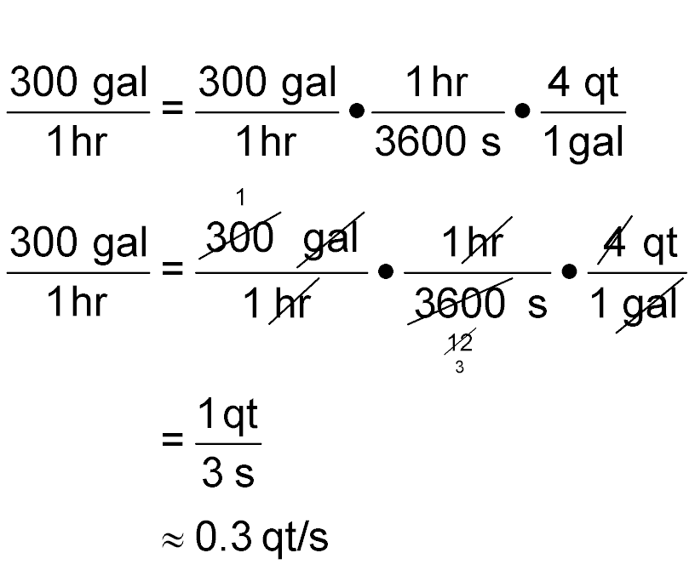
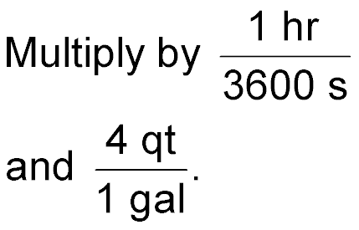
Example 2
Convert Rates
SWIMMING POOL A swimming pool is being filled with water at about 300 gallons per hour. How many quarts per second is this?
You need to convert gallons per hour to quarts per second.
Use 1 gal = 4 qt and 1 hr = 3600 s.

Slide 15
Example 2
Convert Rates
Divide the common factors and units.
Multiply.
Simplify.
Answer: So, 300 gallons per hour is equivalent to about 0.3 quart per second.

Slide 16
Example 2
A train travels 1440 miles per day. How many feet per minute is this?
A. 88 ft/min
B. 880 ft/min
C. 1056 ft/min
D. 5280 ft/min

Slide 17
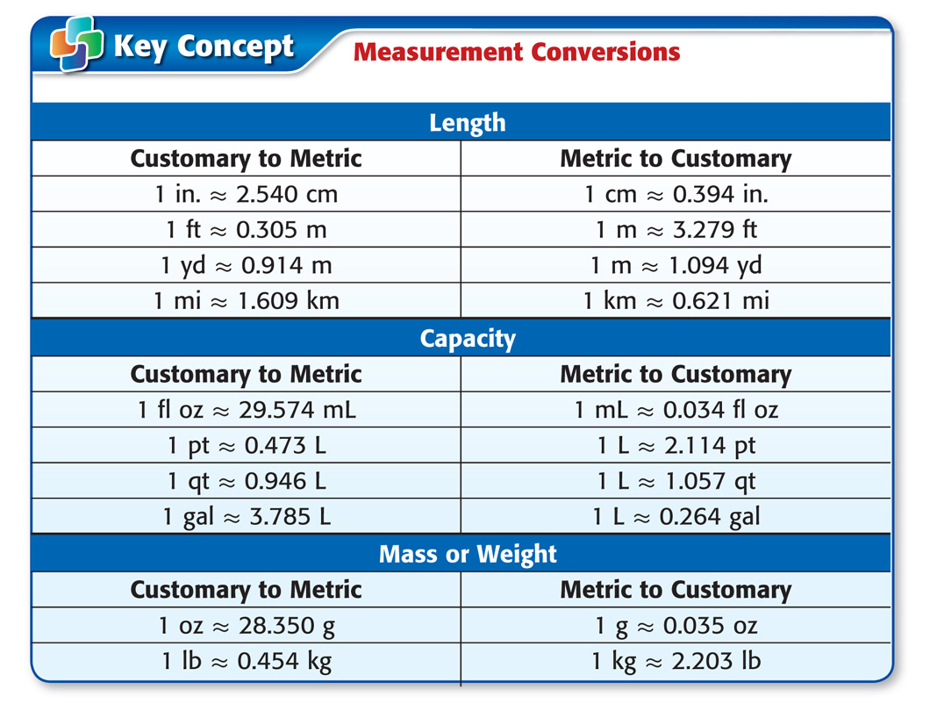
Concept

Slide 18
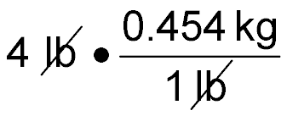
Example 3
Convert Measurements Between Systems
A. Convert 4 pounds to kilograms. Round to the nearest hundredth.
Use 1 pound ≈ 0.454 kilogram.
4 lb ≈
Divide out common units, leaving kilograms.
≈ 1.82 kg
Simplify.
Answer: So, 4 pounds is approximately 1.82 kilograms.

Slide 19
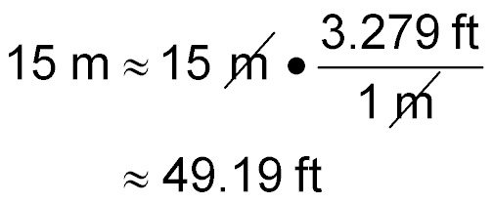
Example 3
Convert Measurements Between Systems
B. Convert 15 meters to feet. Round to the nearest hundredth.
Use 1 m ≈ 3.279 ft.
Divide out common units, leaving feet.
Simplify.
Answer: So, 15 meters is approximately 49.19 feet.

Slide 20
Example 3
A. About how many meters are equal to 5 feet?
A. 0.153 m
B. 1.53 m
C. 1.70 m
D. 16.40 m

Slide 21
Example 3
B. About how many quarts are equal to 7 liters?
A. 3.31 qt
B. 7.66 qt
C. 7.40 qt
D. 14.80 qt

Slide 22
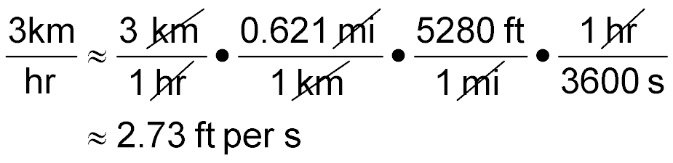
Example 4
Convert Rates Between Systems
CYCLING A cyclist is cycling about 3 kilometers per hour. Rounded to the nearest hundredth, how many feet per second is this?
Use 1 km ≈ 0.621 mi, 1 mi = 5280 ft, and 1 hr = 3600 s.
Divide out common units.
Simplify.

Slide 23
Example 4
Convert Rates Between Systems
Answer: So, 3 kilometers per hour is approximately 2.73 feet per second.

Slide 24
Example 4
A car is traveling 40 miles per hour. About how many kilometers per second is this?
A. 0.018 km/s
B. 0.198 km/s
C. 1.073 km/s
D. 64.36 km/s

Slide 25
End of the Lesson

